Slide 1

Joins I

Slide 2
Intro to Joins
Read Chapter 10 (R4DS)
Read Chapter 19 (R4DS2)
Usually, Multiple Tables of Data are Used in Analysis
Data Must Be Merged Prior to Analysis
Requires Attention to Detail
Fundamental Concept in Data Science

Slide 3
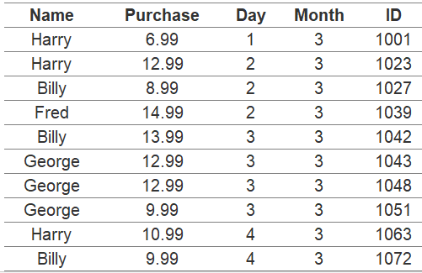
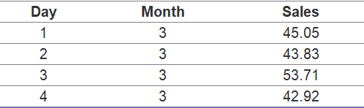
Sample Data
Transaction Data (Members Only)
Sales Data

Slide 4
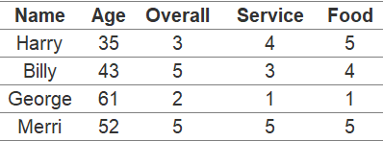
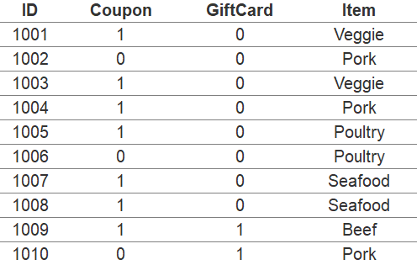
Sample Data
Survey Data
Order Data (All Customers)

Slide 5
Sample Data
Scenario: Restaurant Owner
Why Connect the Data?
What Questions Can We Answer?
What Insights Might We Learn?

Slide 6
Keys
The Variable(s) That Uniquely Identify an Observation
Two Types:
Primary = Uniquely Identifies an Observation in Its Own Table
Foreign = Uniquely Identifies an Observation in Another Table

Slide 7
Keys
Identifying the Primary Keys
ID is a Primary Key for Both Transaction and Order Data
Day + Month is a Primary Key for Sales Data (Compound Key)
Name is a Primary Key for Survey Data
Identifying Foreign Keys
Name is not a Primary Key in Transaction Data
Name in Transaction Data is a Foreign Key in Survey Data

Slide 8
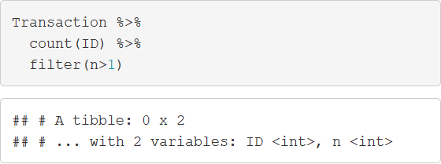
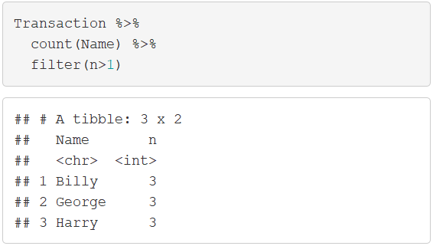
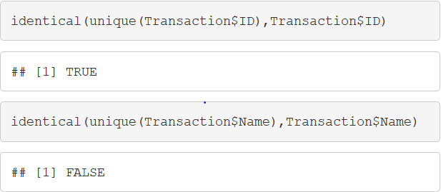
Keys
Verifying the Primary Keys

Slide 9
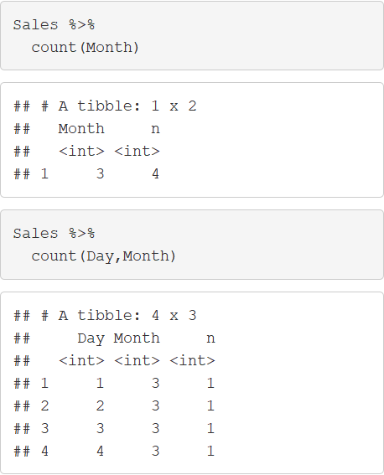
Keys
Verifying the Primary Keys

Slide 10
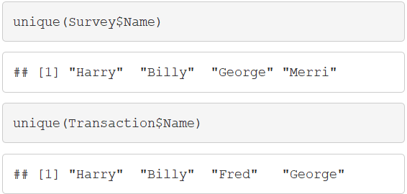
Mutating Joins
Inner Joins
Matches Observations When Their Keys are Equal
Equivalent to
Example: Survey + Transaction
> merge(x,y)

Slide 11
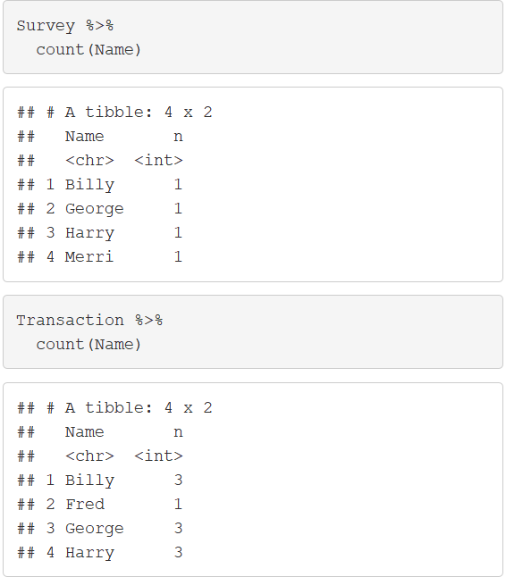
Mutating Joins
Inner Joins
Example: Survey + Transaction

Slide 12
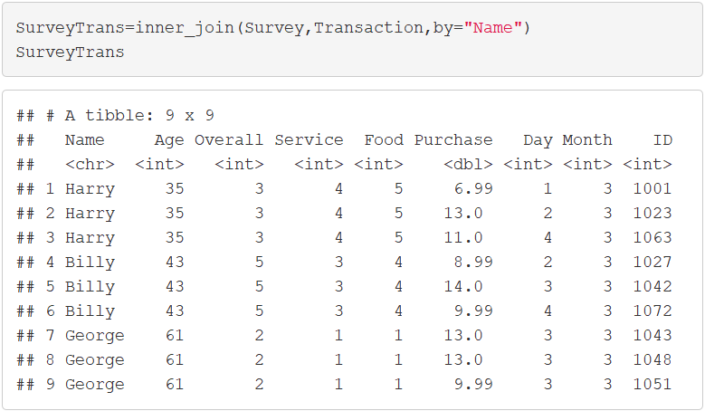
Mutating Joins
Inner Joins
Example: Survey + Transaction

Slide 13
Mutating Joins
Outer Joins
Left-Join
Keeps All Observations in Left Dataset
Equivalent to
> merge(x,y,all.x=TRUE)

Slide 14
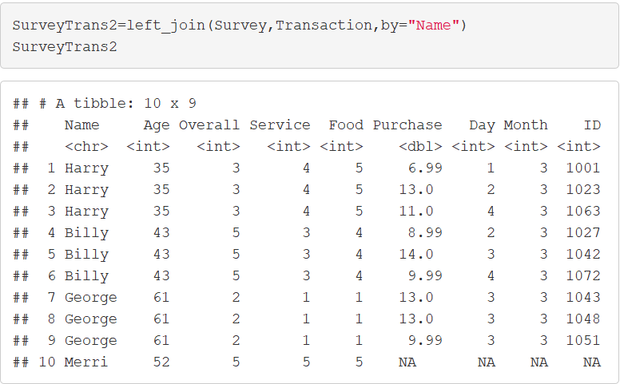
Mutating Joins
Outer Joins
Left-Join
Example: Survey + Trans.

Slide 15
Mutating Joins
Outer Joins
Right-Join
Keeps All Observations in Right Dataset
Equivalent to
> merge(x,y,all.y=TRUE)

Slide 16
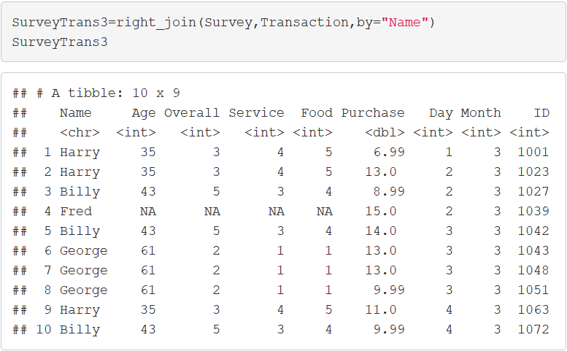
Mutating Joins
Outer Joins
Right-Join
Example: Survey + Trans.

Slide 17
Mutating Joins
Outer Joins
Full-Join
Keeps All Observations in Both Datasets
Equivalent to
> merge(x,y,all.x=TRUE,all.y=TRUE)

Slide 18
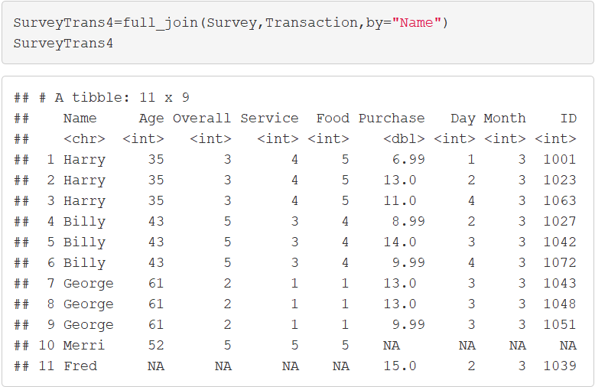
Mutating Joins
Outer Joins
Full-Join
Example: Survey + Trans.

Slide 19
Mutating Joins
Duplicate Keys
All Examples Illustrate the Scenario When Keys Repeat
One to Many Relationship
“Usually” Indicates Error
Identify Your Most Important Dataset
Summarize then Merge

Slide 20
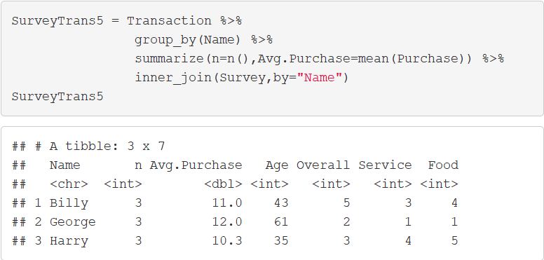
Mutating Joins
Duplicate Keys
Example

Slide 21
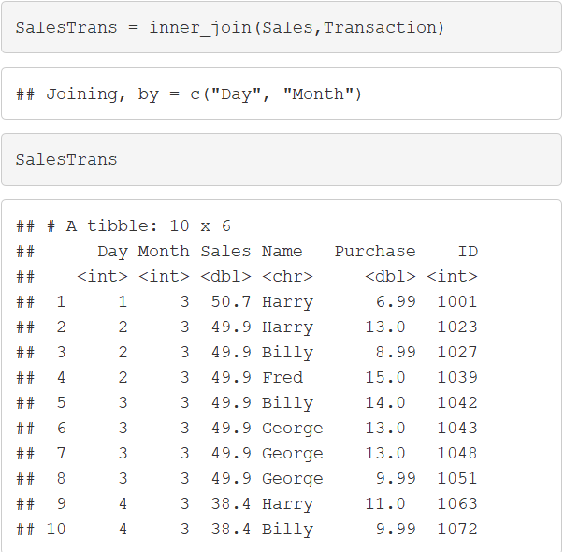
Mutating Joins
Defining the Key Columns
Default: Uses All Variables that Appear in Both Tables

Slide 22
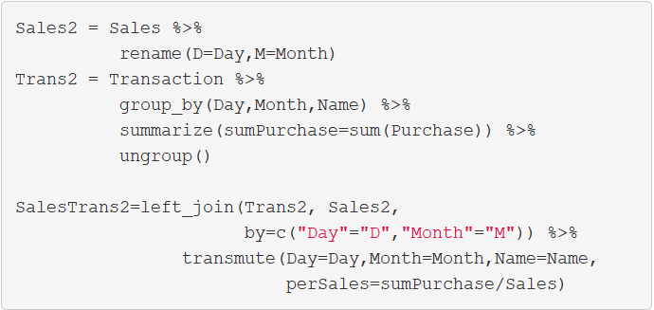
Mutating Joins
Defining the Key Columns
Keys Based on Multiple Variables
Key Names Can Be Different

Slide 23
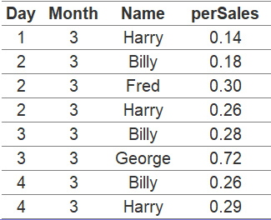
Mutating Joins
Defining the Key Columns

Slide 24
Filtering Joins
Semi-Join
Keeps All Observations in Left Dataset That Have a Match in Right Dataset
Primary Data = Left
Scenario: Want All Order Data Only For Select Customers
> semi_join(x,y)

Slide 25
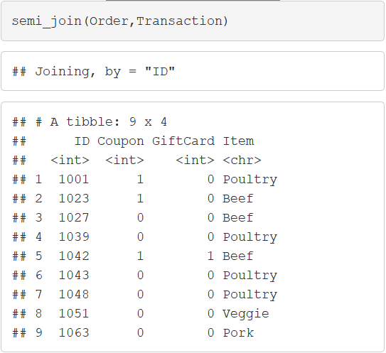
Filtering Joins
Semi-Join

Slide 26
Filtering Joins
Anti-Join
Drops All Observations in Left Dataset That Have a Match in Right Dataset
Primary Data = Left
Scenario: Want All Order Data Except For Select Customers
> anti_join(x,y)

Slide 27
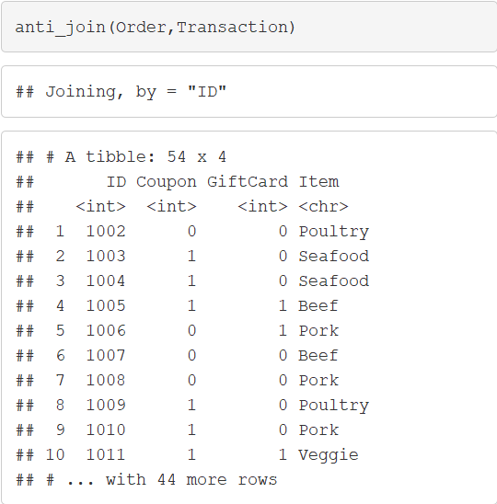
Filtering Joins
Anti-Join

Slide 28
Closing
Disperse and Make Reasonable Decisions

